Slide 1
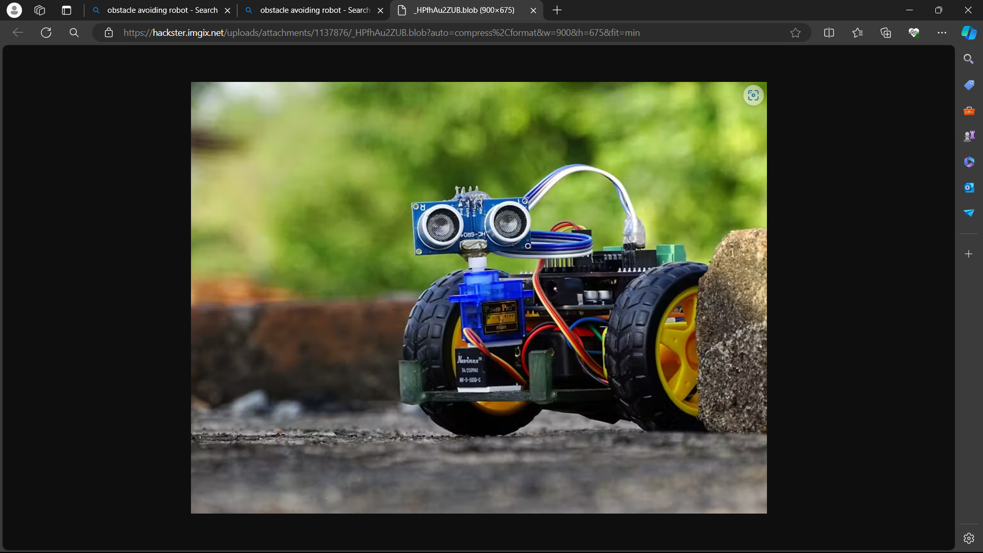


Dayananda Sagar University
Avoido
Presented by
C Vishnu ENG22AM0007
Hemanth S R ENG22AM0024
Nithya Shetty ENG22AM0037
Ullas ENG22AM0066
Ha

Slide 2
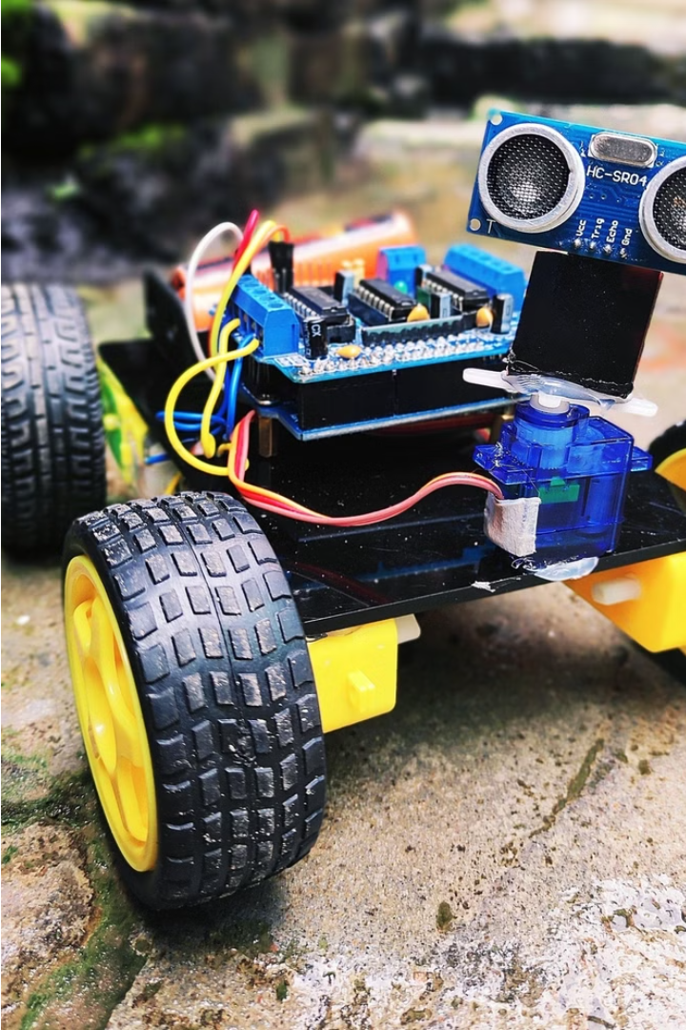
Introduction to the Obstacle Avoiding Robot
In the real world, navigating through obstacles can often be a challenging task, requiring careful planning and quick reflexes to avoid collisions. Whether it's maneuvering through a crowded street or traversing a cluttered workspace, the ability to detect and avoid obstacles is crucial for efficient and safe movement. This necessity has inspired the development of obstacle-avoiding robots, which mimic the problem-solving abilities of living organisms to navigate complex environments autonomously.

Slide 3



Problem Statement and Solution
Problem Statement
Solution Approach
Key Features
Developing an efficient obstacle-avoiding bot with an integrated LCD Display to navigate through dynamic environments
The robot utilizes advanced sensors and algorithms to detect obstacles in its path, then plans and executes the optimal navigation strategy to safely reach its destination while avoiding collisions.
The robot is equipped with ultrasonic, infrared, and visual sensors to identify obstacles, as well as intelligent path planning and control algorithms to maneuver around them.

Slide 4
Project Objectives
Enhanced Workplace safety
Real-Time Hazard
Detection
Productivity optimization
Performance Analysis
The bot proactively navigates through industrial environments, mitigating collision risks and ensuring a safer workplace
Through its sensors and LCD display, the bot instantly alerts workers to potential hazards, enabling swift preventive actions
By providing real-time status updates, the bot facilitates streamlined workflows and minimizes disruptions, thereby enhancing productivity.
Continuous monitoring and evaluation of the bot’s navigation capabilities, allowing for ongoing refinement and optimization to maintain peak performance levels.

Slide 5
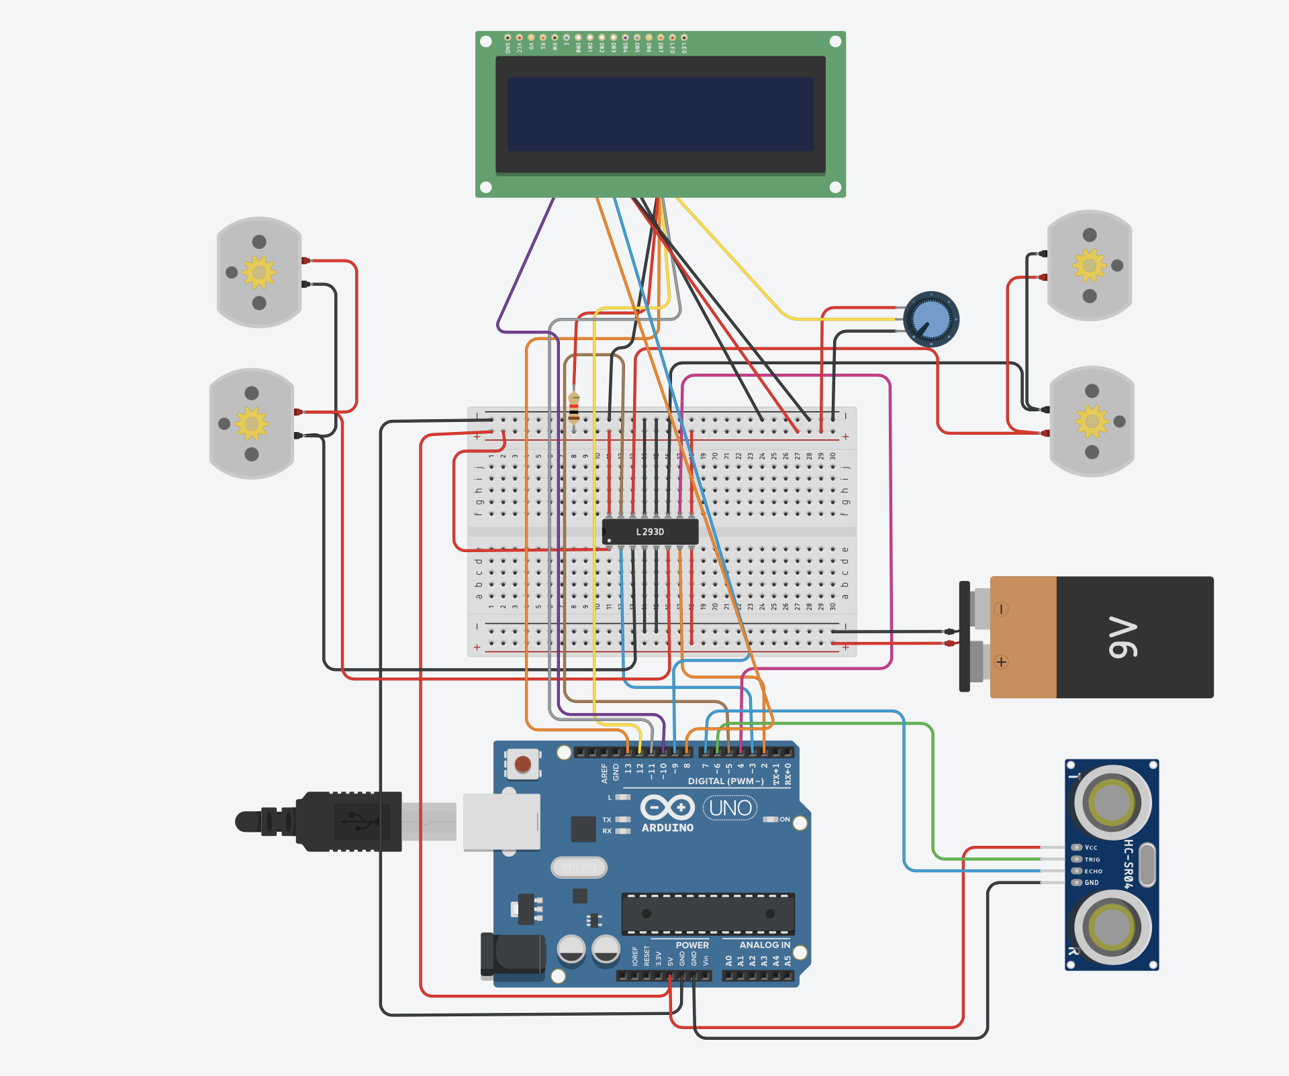
Simulation

Slide 6



Working
Obstacle Detection
1
Sensors scan the environment for obstacles
Path Planning
2
Algorithm calculates the optimal path to navigate
Motion Control
3
Actuators move the robot to follow the planned path
The obstacle avoiding robot works by continuously monitoring its surroundings using advanced sensors. When an obstacle is detected, the on-board microcontroller analyzes the situation and calculates the best path to navigate around the obstruction. The robot's motors and wheels then execute the planned maneuver, allowing the device to seamlessly avoid the obstacle and continue on its intended course.

Slide 7
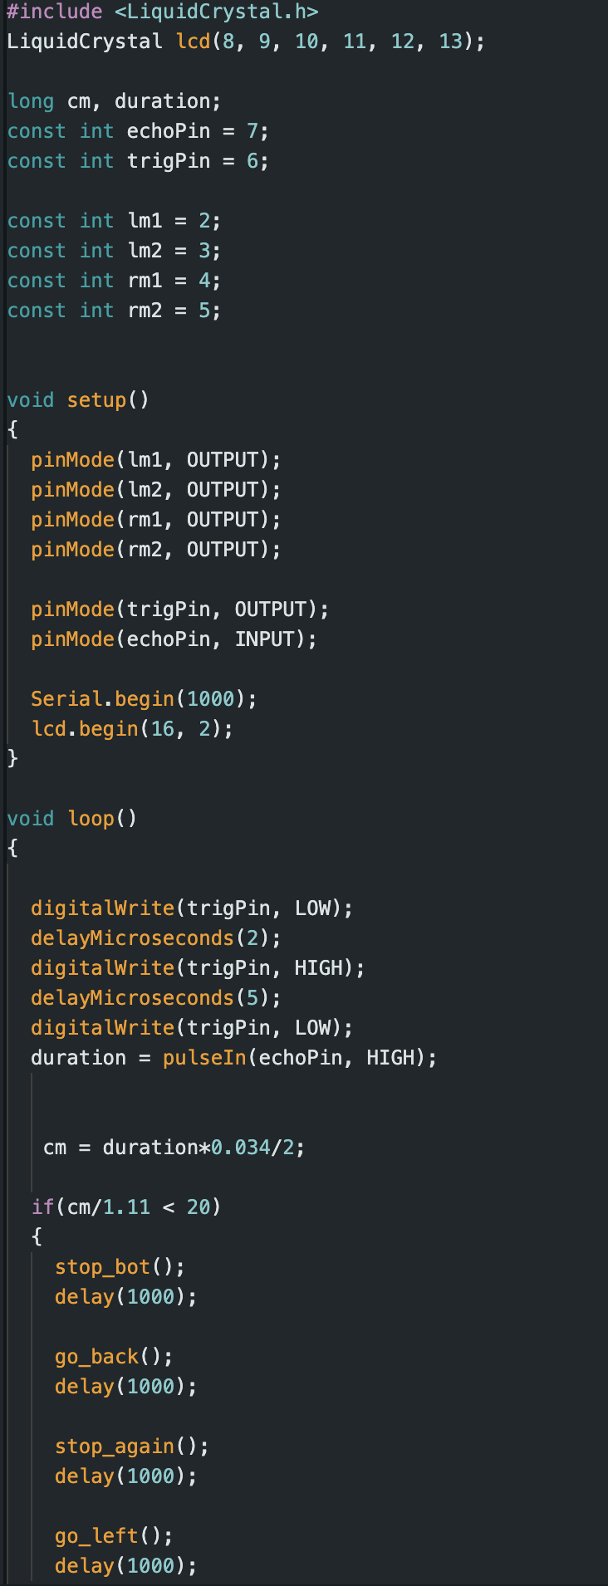
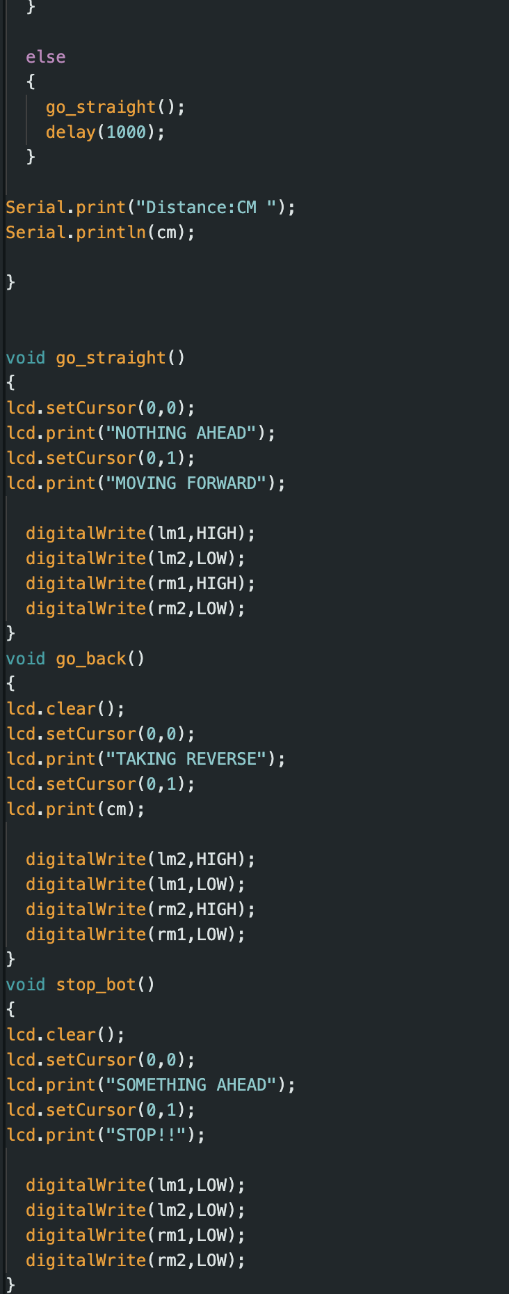
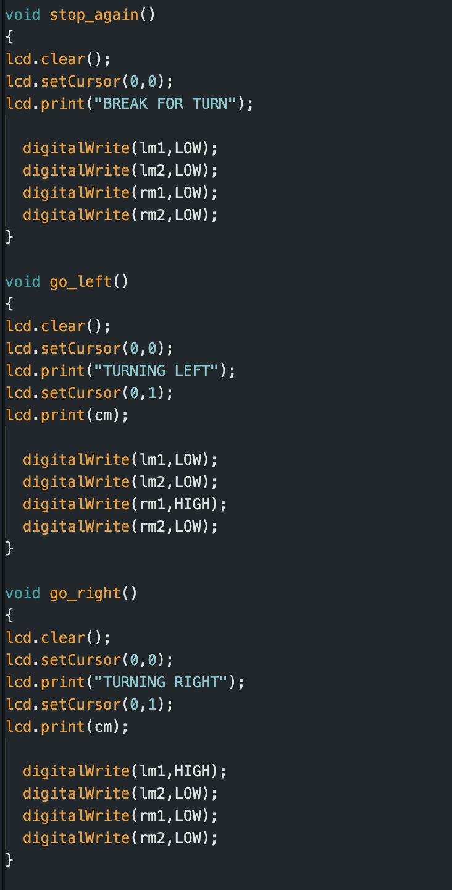
Source Code

Slide 8
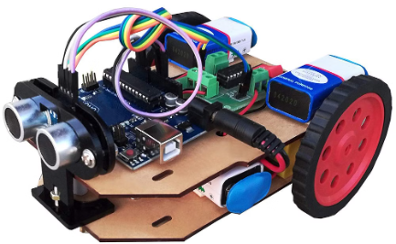
Sensor Integration
Ultrasonic Sensors
Ultrasonic sensors use sound waves to accurately measure the distance to surrounding objects, enhancing the robot's obstacle avoidance capabilities.

Slide 9
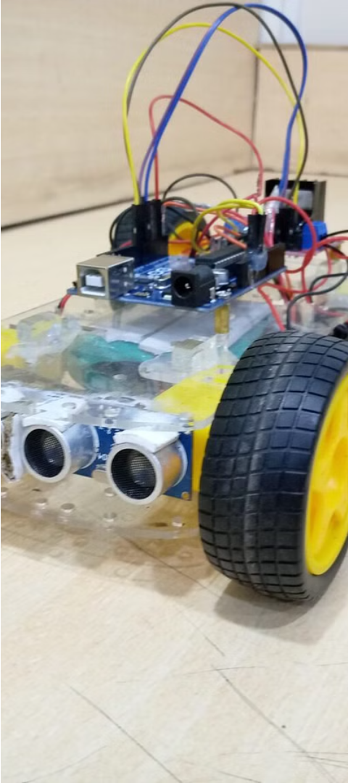
Obstacle Detection Algorithm
1
Sensor Integration
The robot utilizes a combination of sensors, such as infrared and ultrasonic, to detect obstacles in its path with high accuracy and reliability.
2
Distance Mapping
The sensor data is processed to create a real-time map of the surrounding environment, allowing the robot to identify the location and size of obstacles.
3
Adaptive Algorithms
Advanced algorithms continuously analyze the sensor data, enabling the robot to adapt its movement and navigation to avoid collisions with dynamic obstacles.

Slide 10
Methodology
Hardware Integration
1
Seamlessly combining sensors and microcontrollers
Software Architecture
2
Developing the control algorithm and navigation logic
Prototype Testing
3
Iterative improvements through real-world evaluations
The methodology for our obstacle avoiding robot project involves three key steps. First, we'll integrate the hardware components, including the sensors, motors, and microcontroller, to create a cohesive system. Next, we'll develop the software architecture, designing the control algorithm and navigation logic to enable the robot to detect and avoid obstacles. Finally, we'll extensively test the prototype, making iterative improvements based on real-world evaluations to ensure optimal performance.

Slide 11
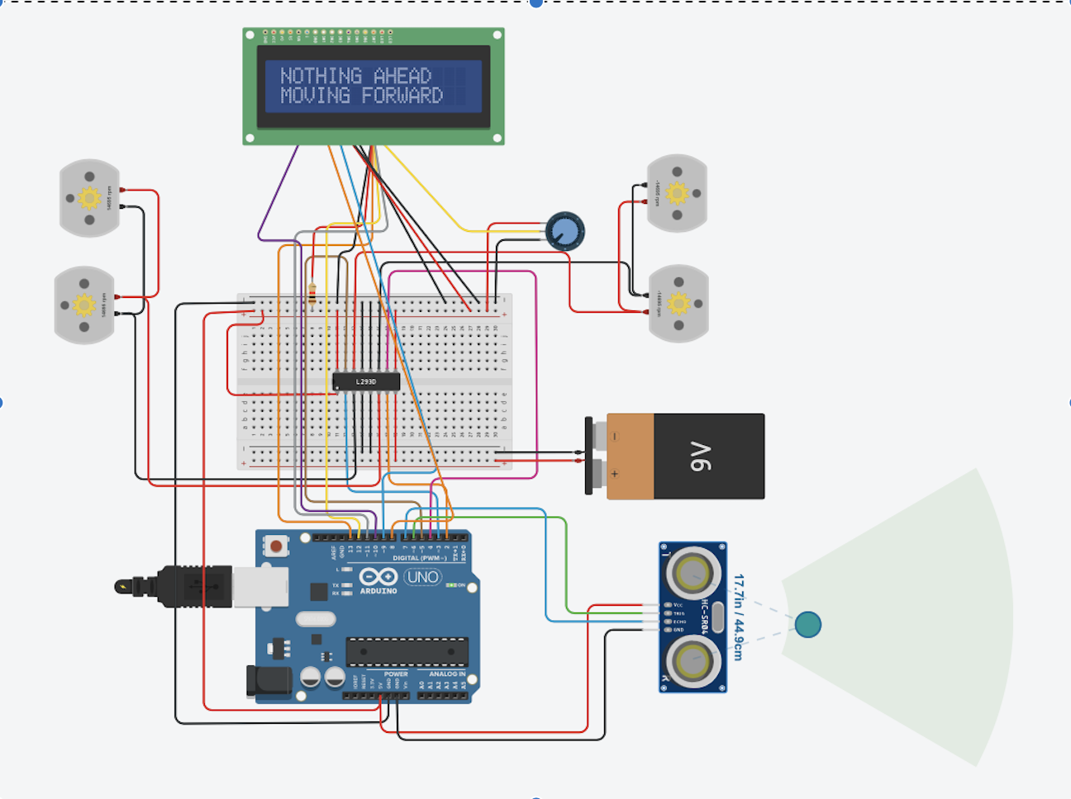
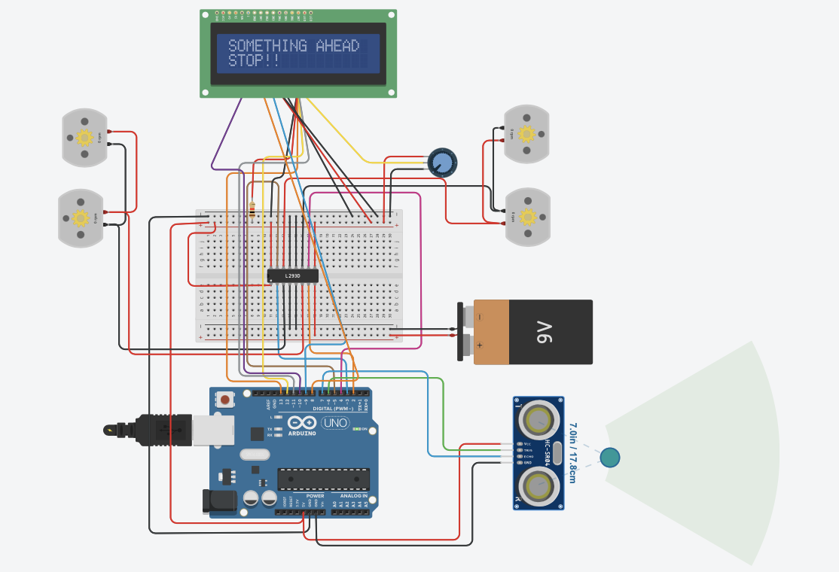
Result And Analysis

Slide 12
Application
Obstacle-avoiding bots is equipped with sensors and processing power to detect and navigate around obstacles in their path.
Domestic tasks
Hazardous environments
Logistics and warehousing
Exploration

Slide 13
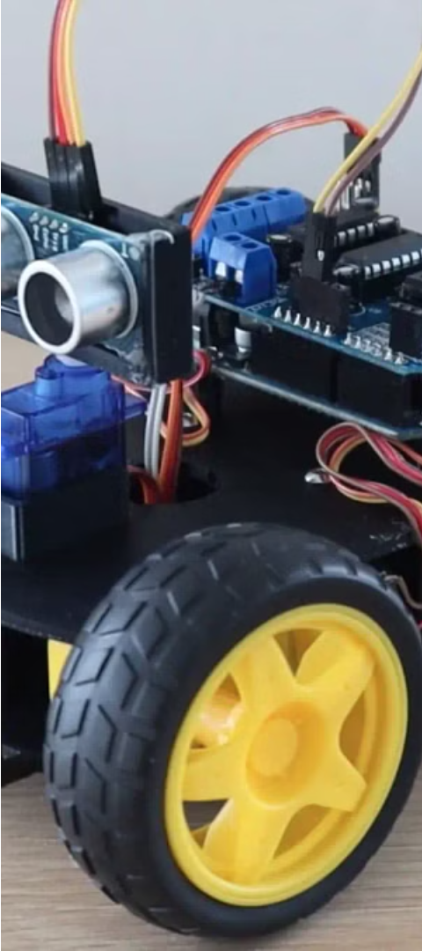
Conclusion and Future Enhancements
Proven Concept
Potential Improvements
The obstacle avoiding robot prototype has successfully demonstrated its ability to navigate through cluttered environments, avoiding collisions and reaching its destination safely.
Future iterations could incorporate advanced sensors, more sophisticated algorithms, and enhanced mobility to handle a wider range of obstacles and environments.
Expanded Applications
With further development, this technology could be applied in areas such as search and rescue operations, autonomous transportation, and industrial automation, improving safety and efficiency.

